Slide 1

Welcome !
2018 Spring CS101 Introduction to Programming

Slide 2
Week 1
Introduction
+ Course Logistics + Some tiny bit of python

Slide 3
What will you learn in CS101?

Slide 4
Our goal in CS101

Slide 5
Our goal in CS101
To learn Computational Thinking !

Slide 6
What is computational thinking?
It’s a problem solving process with the following three steps.

Slide 7
What is computational thinking?
It’s a problem solving process with the following three steps.
Step 1. Formulate a problem

Slide 8
What is computational thinking?
Problem:
How do you make a chocolate chip cookie?
It’s a problem solving process with the following three steps.
Step 1. Formulate a problem

Slide 9
What is computational thinking?
Problem:
How do you make a chocolate chip cookie?
Formulate:
Ingredients (flour, salt, baking soda, chocolate, etc.)
cooking tools (oven, baking sheet, spatula, etc.)
It’s a problem solving process with the following three steps.
Step 1. Formulate a problem

Slide 10
What is computational thinking?
It’s a problem solving process with the following three steps.
Step 1. Formulate a problem
Step 2. Learn to express the solution in a way a computer (a machine or a human) can understand and effectively carry out → “instruction”

Slide 11
What is computational thinking?
Problem:
How do you make a chocolate chip cookie?
Formulate:
Ingredients (flour, salt, baking soda, chocolate, etc.)
cooking tools (oven, baking sheet, spatula, etc.)
It’s a problem solving process with the following three steps.
Step 1. Formulate a problem
Step 2. Learn to express the solution in a way a computer (a machine or a human) can understand and effectively carry out → “instruction”
Instruction:
Preheat oven
Make dough
Mix sugar, flour, egg, salt
Batter
Bake in the oven

Slide 12
What is computational thinking?
It’s a problem solving process with the following three steps.
Step 1. Formulate a problem
Step 2. Learn to express the solution in a way a computer (a machine or a human) can understand and effectively carry out → “instruction”
Step 3. Execute

Slide 13
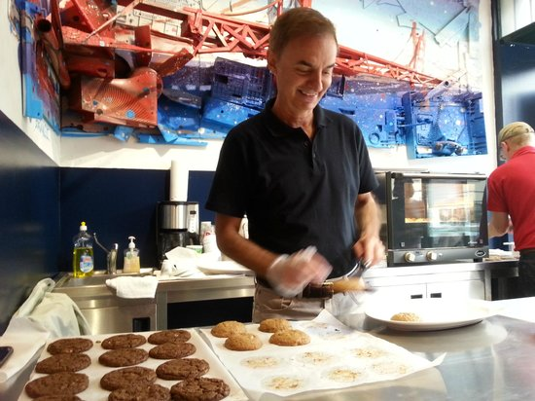
What is computational thinking?
Problem:
How do you make a chocolate chip cookie?
Formulate:
Ingredients (flour, salt, baking soda, chocolate, etc.)
cooking tools (oven, baking sheet, spatula, etc.)
It’s a problem solving process with the following three steps.
Step 1. Formulate a problem
Step 2. Learn to express the solution in a way a computer (a machine or a human) can understand and effectively carry out → “instruction”
Step 3. Execute
Instruction:
Preheat oven
Make dough
Mix sugar, flour, egg, salt
Batter
Bake in the oven

Slide 14

What is computational thinking?
It’s a problem solving process with the following three steps.
Step 1. Formulate a problem
Step 2. Learn to express the solution in a way a computer (a machine or a human) can understand and effectively carry out
Step 3. Execute
It’s 2018, and if you think you are better off at solving problems by writing down equations with pencils on paper, think again.
We will use computer programming We will use a programming language called Python

Slide 15
What is computational thinking?
It’s a problem solving process with the following three steps.
Step 1. Formulate a problem
Step 2. Learn to express the solution in a way a computer (a machine or a human) can understand and effectively carry out
Step 3. Execute
It’s 2017, and if you think you are better off at solving problems by writing down equations with pencils on paper, think again.
We will use computer programming We will use a programming language called Python
We will learn how to solve problems by computational thinking with the help of Python programming language

Slide 16
questions?

Slide 17
Course Logistics

Slide 18
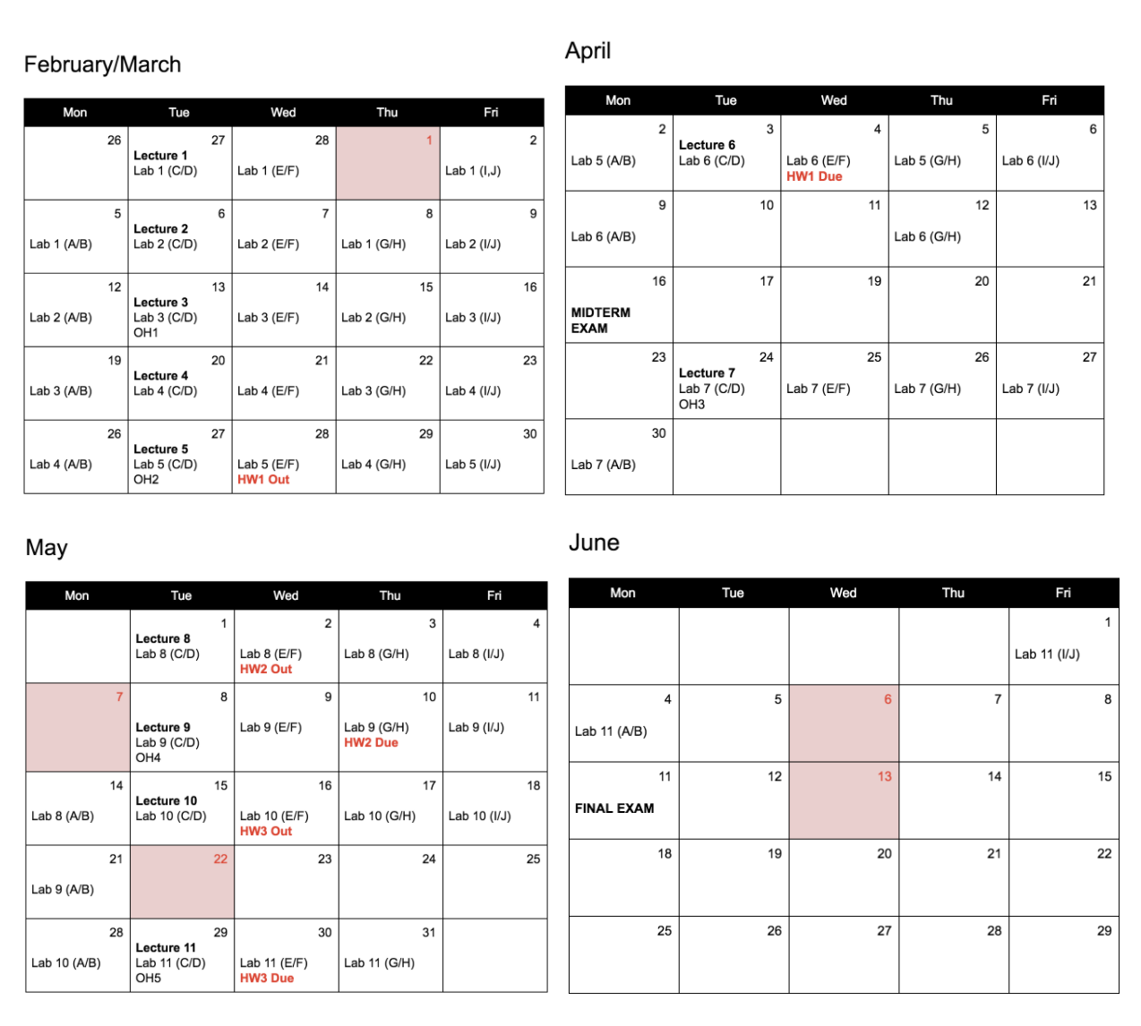
Course Structure & Schedule
11 Lectures
3 Homework Assignments
cs101.kaist.ac.kr
→ Syllabus
10 Labs
2 Exams
(Midterm and Final)

Slide 19
Course Structure & Schedule
SORRY!!
THE SYLLABUS NEEDS A SIGNIFICANT UPDATE!
PLEASE RE-VISIT NEXT WEEK!!
11 Lectures
3 Homework Assignments
cs101.kaist.ac.kr
→ Syllabus
10 Labs
2 Exams
(Midterm and Final)

Slide 20
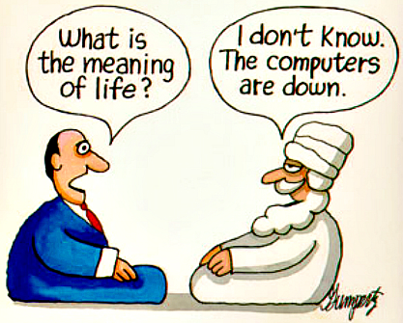
TA Office Hours
Where & When?
Creative Learning Building (this building) Rm #307
21:00 ~ 22:30 on days marked “OH” on the schedule
OH
About What?
TA OH are appointment-based, and there will be sign up sheets!
We welcome any questions including the following but not limited to:
Lecture, lab, homework assignments, life, rabbits, etc.

Slide 21
Let’s look at the schedule
Schedule

Slide 22
Course Structure
11 Lectures
3 Homework Assignments
Everything is scheduled and fixed
WHY?
You can plan your semester NOW
10 Labs
2 Exams
(Midterm and Final)

Slide 23
Grading
YOUR FINAL GRADE
2 Exams (Midterm and Final)
10 Lectures
(100 points)
10 Labs
(100 points)
3 Homework Assignments
(150 points)
Lecture 1 doesn’t count
Your Hard Work
Academic Honesty

Slide 24
YOUR FINAL GRADE
Everyone should’ve signed the honor code.
2 Exams (Midterm and Final)
10 Lectures
(100 points)
10 Labs
(100 points)
3 Homework Assignments
(150 points)
Your Hard Work
Academic Honesty

Slide 25
YOUR FINAL GRADE
Everyone should’ve signed the honor code.
What we consider as CHEATING in CS101:
1. looking at solutions or program code that are not your own (internet, friend, stranger, tutor, etc. )
2. share your solution code with other students
3. NOT indicating on your submission any assistance you received
2 Exams (Midterm and Final)
10 Lectures
(100 points)
10 Labs
(100 points)
3 Homework Assignments
(150 points)
Your Hard Work
Academic Honesty

Slide 26
YOUR FINAL GRADE
Everyone should’ve signed the honor code.
What we consider as CHEATING in CS101:
1. looking at solutions or program code that are not your own (internet, friend, stranger, tutor, etc. )
2. share your solution code with other students
3. NOT indicating on your submission any assistance you received
2 Exams (Midterm and Final)
When violated,
1. Immediate F to BOTH the copier AND the provider 2. Suspension from school
10 Lectures
(100 points)
10 Labs
(100 points)
3 Homework Assignments
(150 points)
Your Hard Work
Academic Honesty

Slide 27
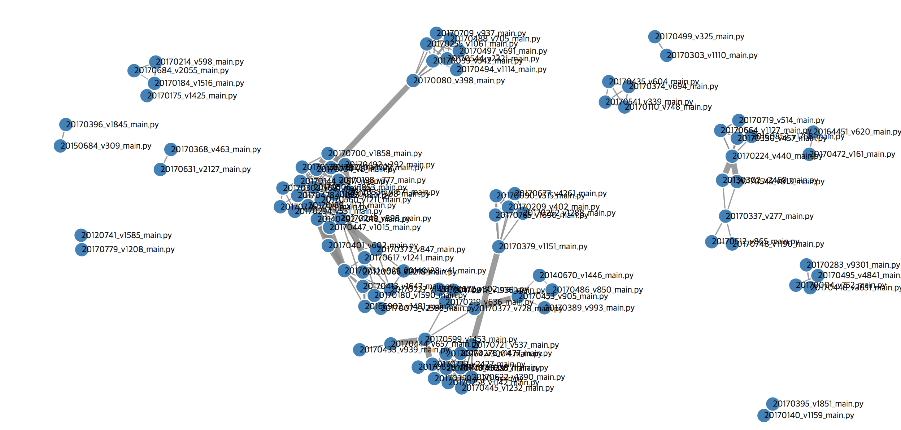
Trust me, we are REALLY good at catching cheaters

Slide 28
YOUR FINAL GRADE
Practice Points >= 300
2 Exams (Midterm and Final)
Lecture 2 ~ Lecture 11
1 Lecture = 10 points
10 Lectures = 100 points
10 Lectures
(100 points)
10 Labs
(100 points)
3 Homework Assignments
(150 points)
Your Hard Work
Academic Honesty

Slide 29
YOUR FINAL GRADE
Practice Points >= 300
2 Exams (Midterm and Final)
1 Lecture = 10 points
10 Lectures = 100 points
10 Lectures
(100 points)
10 Labs
(100 points)
3 Homework Assignments
(150 points)
1 Lab = 10 points
10 Labs = 100 points
Your Hard Work
Academic Honesty

Slide 30
YOUR FINAL GRADE
Practice Points >= 300
2 Exams (Midterm and Final)
1 Lecture = 10 points
10 Lectures = 100 points
10 Lectures
(100 points)
10 Labs
(100 points)
3 Homework Assignments
(150 points)
1 Lab = 10 points
10 Labs = 100 points
1 Homework assignment
= 50 points
3 Homework assignments = 150 points
Your Hard Work
Academic Honesty

Slide 31
YOUR FINAL GRADE
Practice Points >= 300
1 Lecture = 10 points
11 Lectures = 110 points
2 Exams (Midterm and Final)
Total = 350 points
10 Lectures
(100 points)
10 Labs
(100 points)
3 Homework Assignments
(150 points)
1 Lab = 10 points
10 Labs = 100 points
1 Homework assignment
= 50 points
4 Homework assignments = 200 points
Your Hard Work
Academic Honesty

Slide 32
Out of 350 available practice points, you must collect at least 300 points to be considered to be graded on your exam scores.
Otherwise, immediate F.
→ Practice points are a “qualification”
YOUR FINAL GRADE
Practice Points > 300
2 Exams (Midterm and Final)
1 Lecture = 10 points
11 Lectures = 110 points
11 Lectures
10 Labs
4 Homework Assignments
1 Lab = 10 points
10 Labs = 100 points
1 Homework = 50 points
4 Labs = 200 points
Your Hard Work
Academic Honesty

Slide 33
For Example,
YOUR FINAL GRADE
Practice Points > 300
2 Exams (Midterm and Final)
1 Lecture = 10 points
11 Lectures = 110 points
Student A
Theory Point | 170
Practice Point | 300
Final Score | B+
11 Lectures
10 Labs
4 Homework Assignments
1 Lab = 10 points
10 Labs = 100 points
1 Homework = 50 points
4 Labs = 200 points
Your Hard Work
Academic Honesty

Slide 34
For Example,
YOUR FINAL GRADE
Practice Points > 300
2 Exams (Midterm and Final)
1 Lecture = 10 points
11 Lectures = 110 points
Student A
Theory Point | 170
Practice Point | 300
Final Score | B+
11 Lectures
10 Labs
4 Homework Assignments
1 Lab = 10 points
10 Labs = 100 points
≥ 300
(pass)
1 Homework = 50 points
4 Labs = 200 points
Your Hard Work
Academic Honesty

Slide 35
For Example,
YOUR FINAL GRADE
Practice Points > 300
2 Exams (Midterm and Final)
1 Lecture = 10 points
11 Lectures = 110 points
Student A
Theory Point | 170
Practice Point | 300
Final Score | B+
11 Lectures
10 Labs
4 Homework Assignments
1 Lab = 10 points
10 Labs = 100 points
≥ 300
(pass)
1 Homework = 50 points
4 Labs = 200 points
Your Hard Work
Academic Honesty

Slide 36
For Example,
YOUR FINAL GRADE
Practice Points > 300
2 Exams (Midterm and Final)
1 Lecture = 10 points
11 Lectures = 110 points
Student A
Theory Point | 170
Practice Point | 300
Final Score | B+
Student B
Theory Point | 197
Practice Point | 299
Final Score | F
11 Lectures
10 Labs
4 Homework Assignments
1 Lab = 10 points
10 Labs = 100 points
≥ 300
(pass)
< 300
(fail)
1 Homework = 50 points
4 Labs = 200 points
Your Hard Work
Academic Honesty

Slide 37
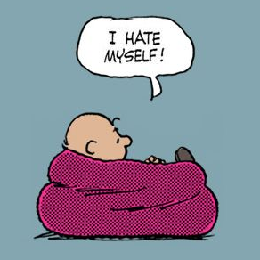
For Example,
YOUR FINAL GRADE
Practice Points > 300
2 Exams (Midterm and Final)
1 Lecture = 10 points
11 Lectures = 110 points
Student A
Theory Point | 170
Practice Point | 300
Final Score | B+
Student B
Theory Point | 197
Practice Point | 339
Final Score | F
11 Lectures
10 Labs
4 Homework Assignments
1 Lab = 10 points
10 Labs = 100 points
Student B
1 Homework = 50 points
4 Labs = 200 points
Your Hard Work
Academic Honesty

Slide 38
YOUR FINAL GRADE
Theory Points
Midterm exam = 100 points
Final exam = 100 points
Total = 200 points
2 Exams (Midterm and Final)
10 Lectures
(100 points)
10 Labs
(100 points)
3 Homework Assignments
(150 points)
Your Hard Work
Academic Honesty

Slide 39
YOUR FINAL GRADE
Your Final Grade
2 Exams (Midterm and Final)
1. You must be academically honest in EVERY part of the course
10 Lectures
(100 points)
10 Labs
(100 points)
3 Homework Assignments
(150 points)
2. You must have collected at least 300 practice points
If you meet both 1. and 2.,
You will be graded only on your two exam (midterm + final) scores
Your Hard Work
Academic Honesty

Slide 40
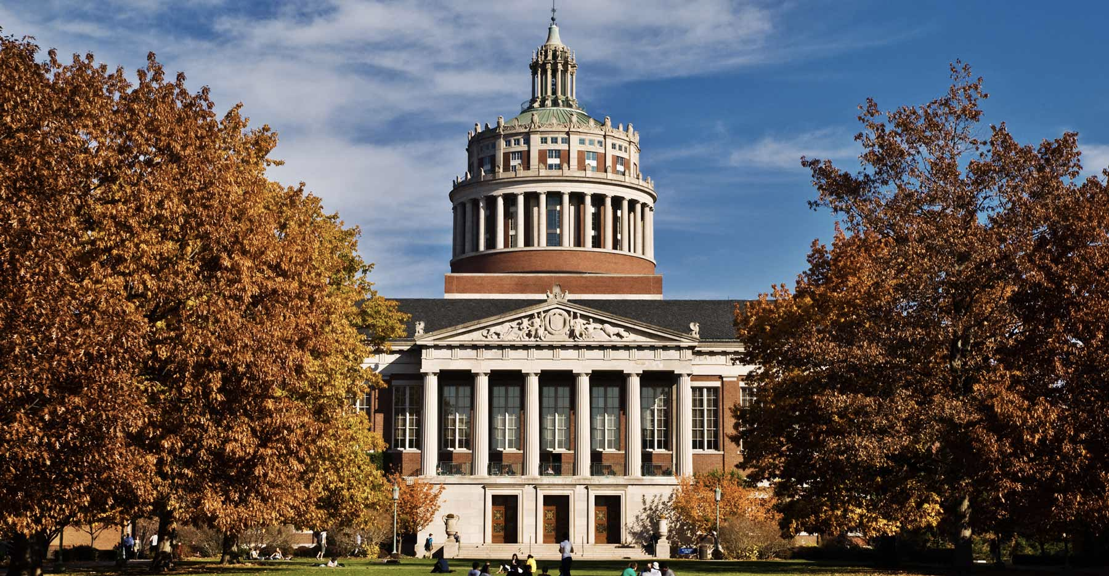
At the end of the semester, your CS101 can look like…

Slide 41

At the end of the semester, your CS101 can look like…

Slide 42
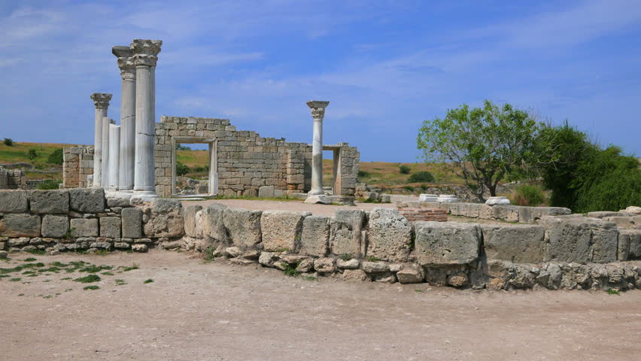
At the end of the semester, your CS101 can look like…

Slide 43
questions?

Slide 44
Homework Assignments

Slide 45
Each Homework
1 week to work on it

Slide 46
Lab sessions

Slide 47
Each Lab
Programming Tasks
(10 points)

Slide 48
Each Lab
Your program must be errorless
AND
You’ll be asked to explain what you did and how you did it to a TA
TA must sign you off
Programming Tasks
(10 points)

Slide 49
Each Lab
Your program must be errorless
AND
You’ll be asked to explain what you did and how you did it to a TA
TA must sign you off
Programming Tasks
(10 points)
Great opportunity for YOU to practice with the TA’s help

Slide 50
Each Lab
Your program must be errorless
AND
You’ll be asked to explain what you did and how you did it to a TA
TA must sign you off
Programming Tasks
(10 points)
Great opportunity for YOU to practice with the TA’s help
Should complete the tasks in lab, NOT at home.

Slide 51
If you’re absent from the lab
You will get 0 points on that week's lab score!!

Slide 52

If you’re absent from the lab
You will get 0 points on that week's lab score!!
NO EXCUSE ACCEPTED
(except your own funeral) No email submission No evaluation on previous lab work

Slide 53
If you’re absent from the lab
Did programming tasks completely in another lab section
Up to 5 points
You may participate in other section’s lab of the same week
You will be awarded 50% of the score

Slide 54
Lab Score Claim
Programming
Tasks
Not My Score !
For each lab, we’re taking score claims for one week and one week only.
ex) lab 3 score claims → until lab 4
Note: same with lecture attendance scores:
Lecture 6 claim → until Lecture 7

Slide 55
questions?

Slide 56
Week 1 Today’s Tasks

Slide 57
What’s Python??
Learning to program is like learning a foreign language, except it’s more fun!
Python is a (programming) language we use to communicate ourselves with a computer, and with other people (through your software)!

Slide 58

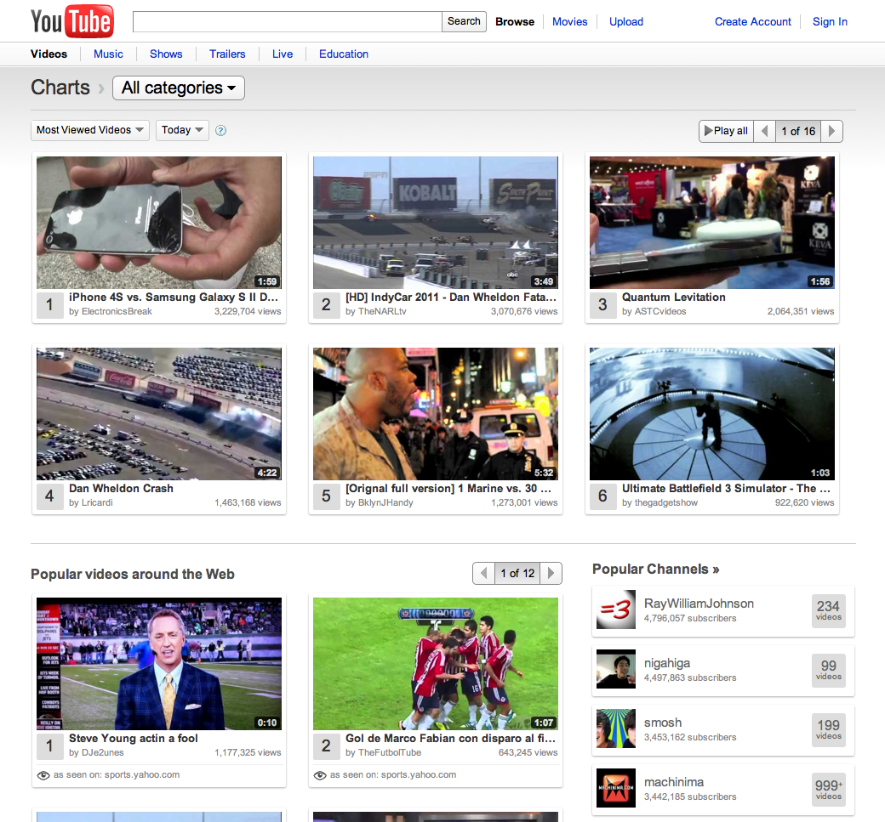

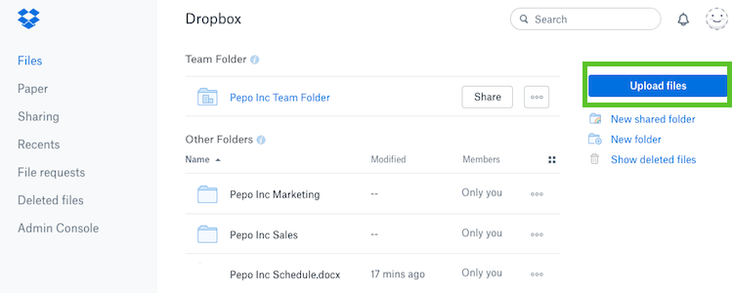
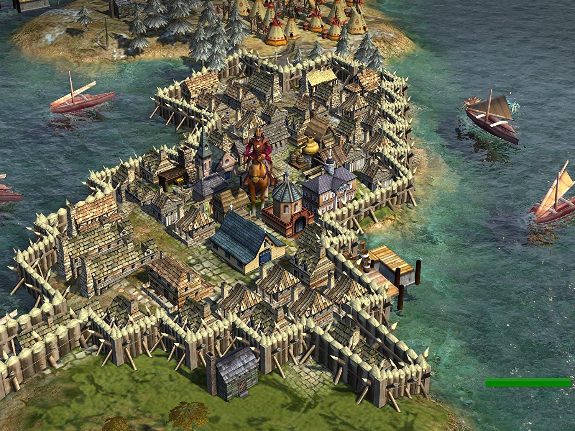

Famous Python Projects
Dropbox
Civilization IV
Battlefield 2
Google
Youtube
Instagram
… and many more!!

Slide 59

You can make one too!

Slide 60
Before we start, we will need to install a couple of things on your computer
Python Programming Language
so that the computer knows which language we’re talking in.
Integrated Development Environment (IDE)
This is like a “chat room”
CS101 specific libraries
These are some of the files needed to do your tasks
Don’t worry about these, we’ll explain what they mean one by one later.

Slide 61
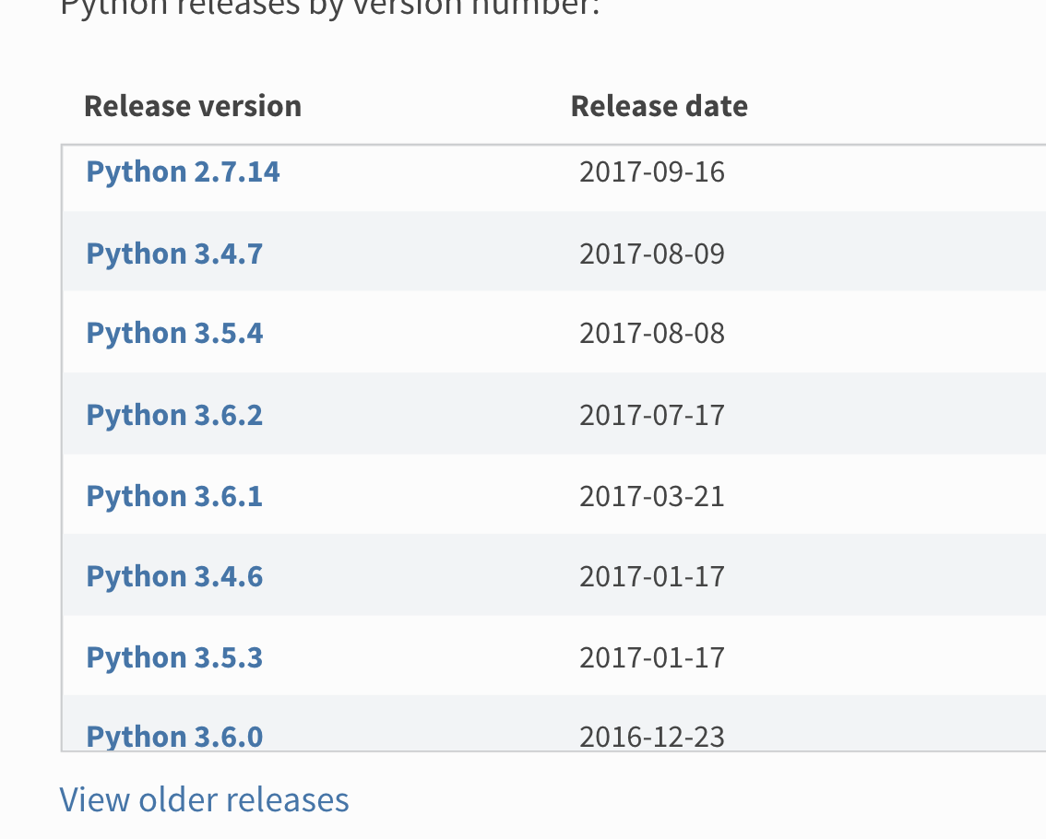
Setting up the Python Environment
Go to https://www.python.org/downloads/, scroll down.
Download Python 3.5.4 → VERY IMPORTANT

Slide 62
just click next, next, next, …

Slide 63

PyCharm
https://www.jetbrains.com/pycharm-edu/

Slide 64
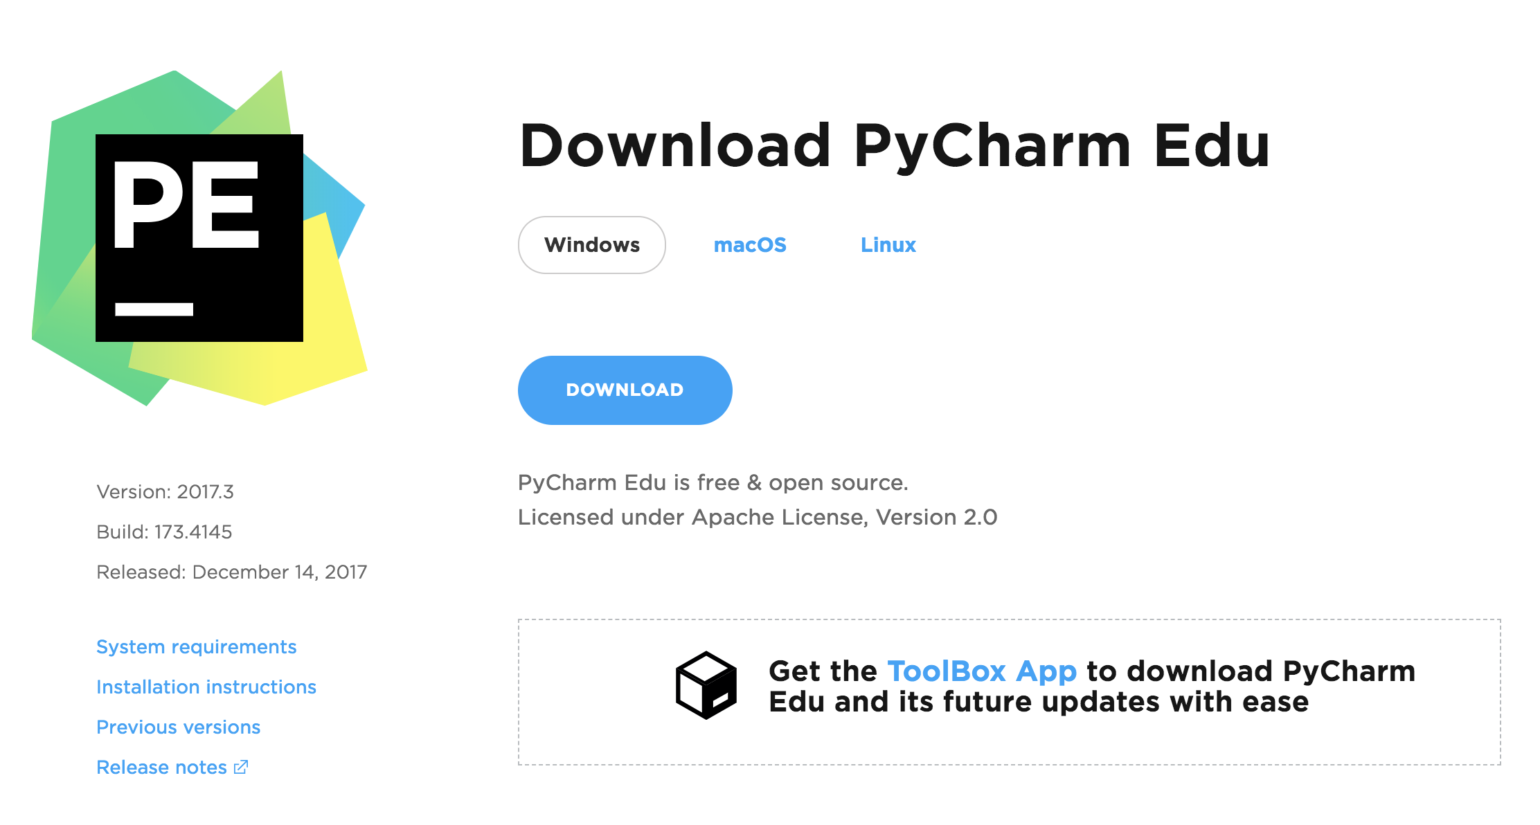

Slide 65
Again, just click next, next, next, …

Slide 66
PILLOW (Image Library)
32bit:
https://pypi.python.org/packages/3.5/P/Pillow/Pillow-3.1.1.win32-py3.5.exe
64bit:
https://pypi.python.org/packages/3.5/P/Pillow/Pillow-3.1.1.win-amd64-py3.5.exe

Slide 67
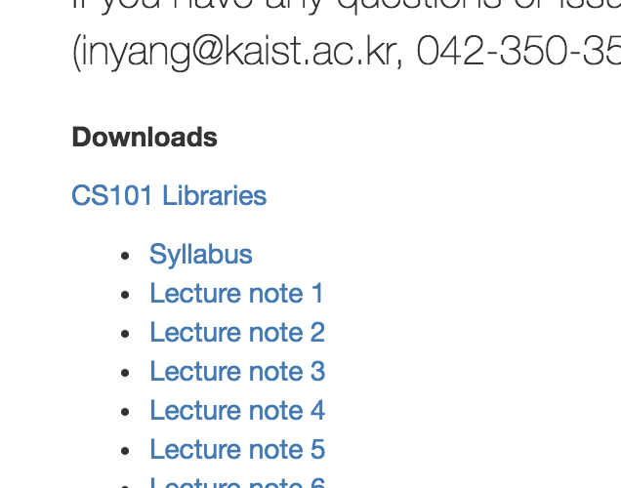
CS101 libraries
Go to http://cs101.kaist.ac.kr

Slide 68
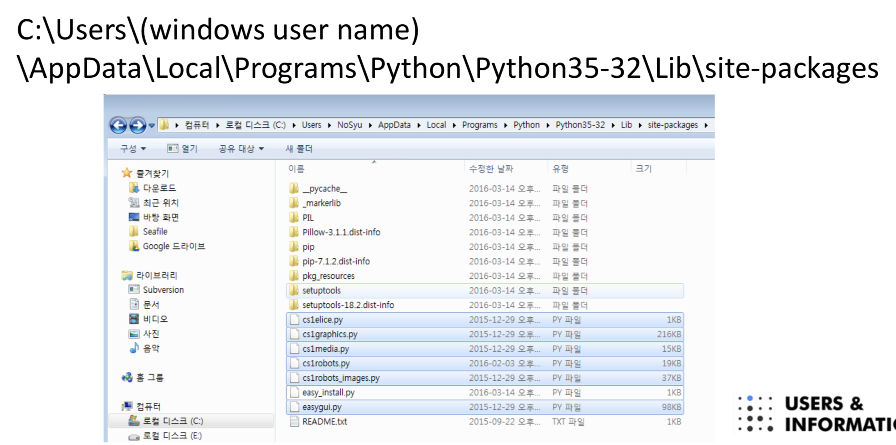
CS101 Libraries

Slide 69
Phew..
Let’s take a 15 second break here.

Slide 70
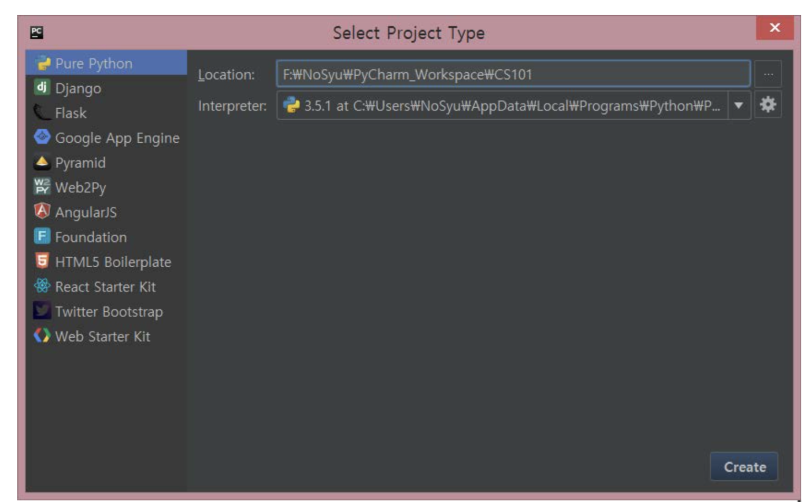
How to use PyCharm
Click “Create new project”
Make sure you remember what you put in here at location.
Interpreter: 3.5.4

Slide 71
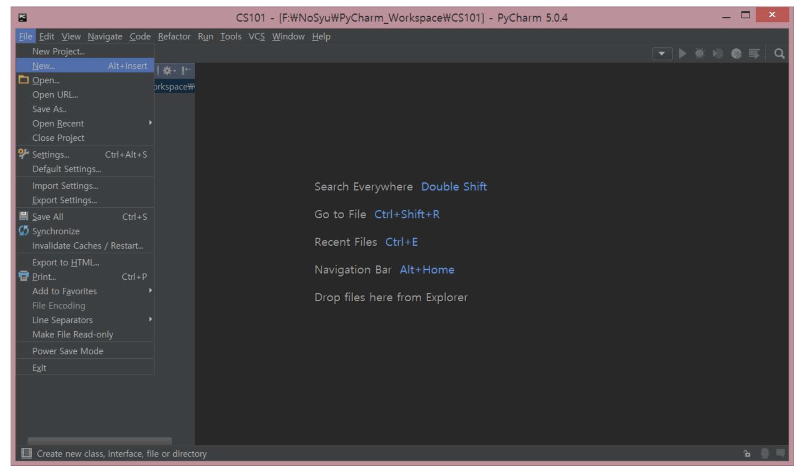
File → New

Slide 72
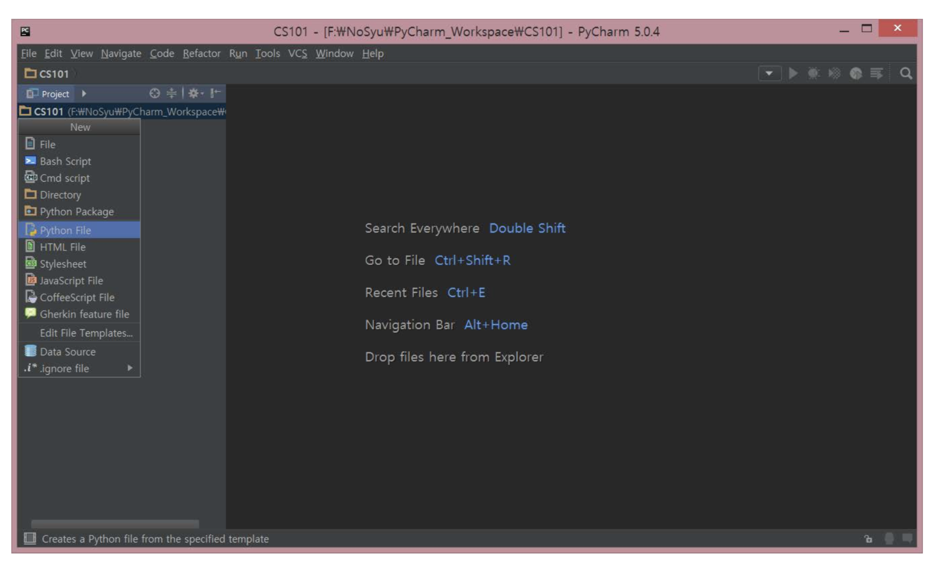
Python File

Slide 73
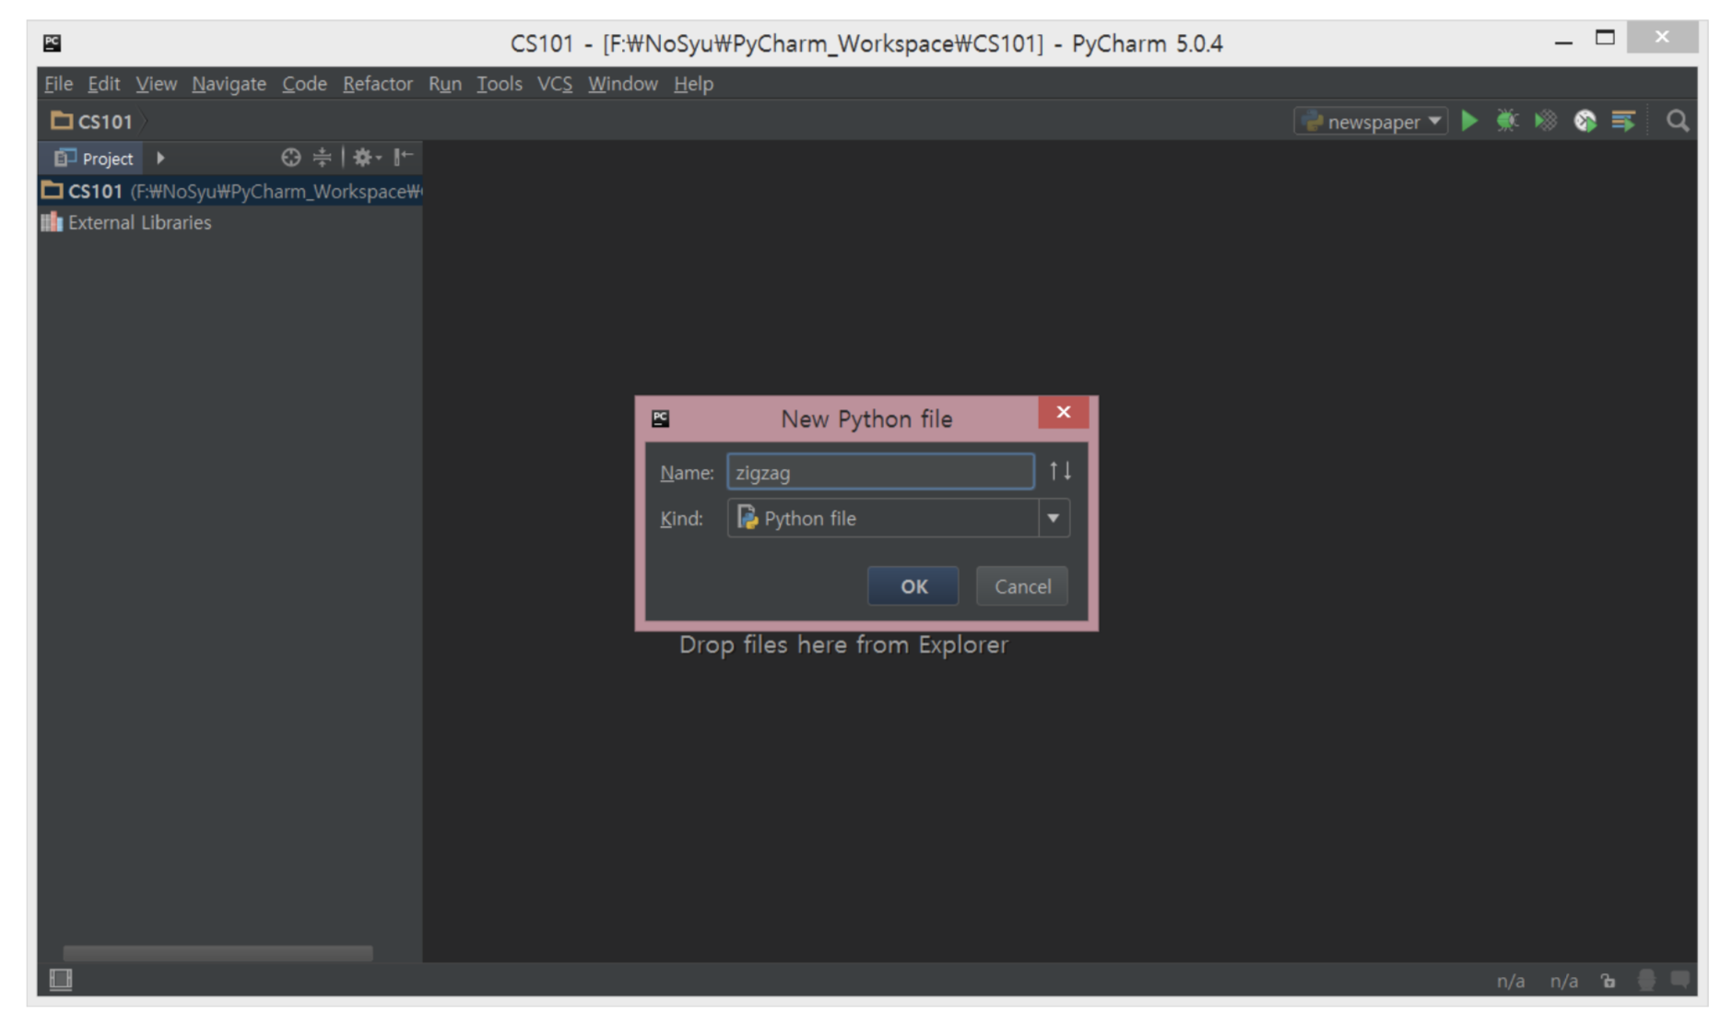
Give it a name

Slide 74
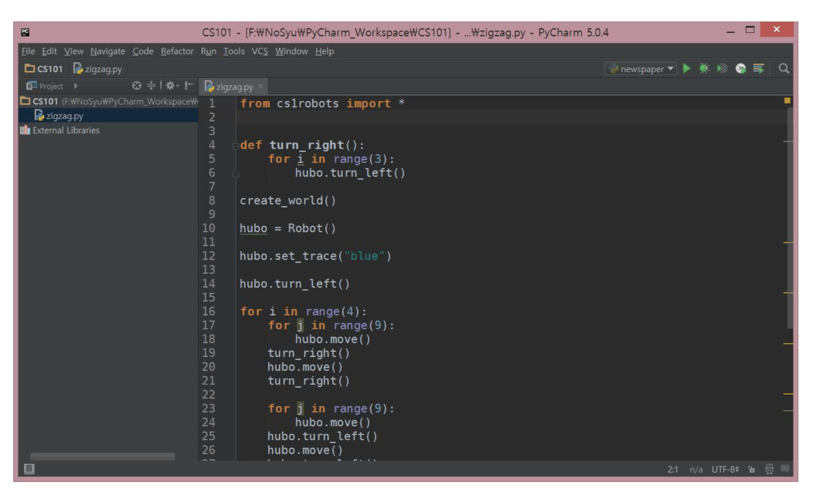
Write your program!!

Slide 75
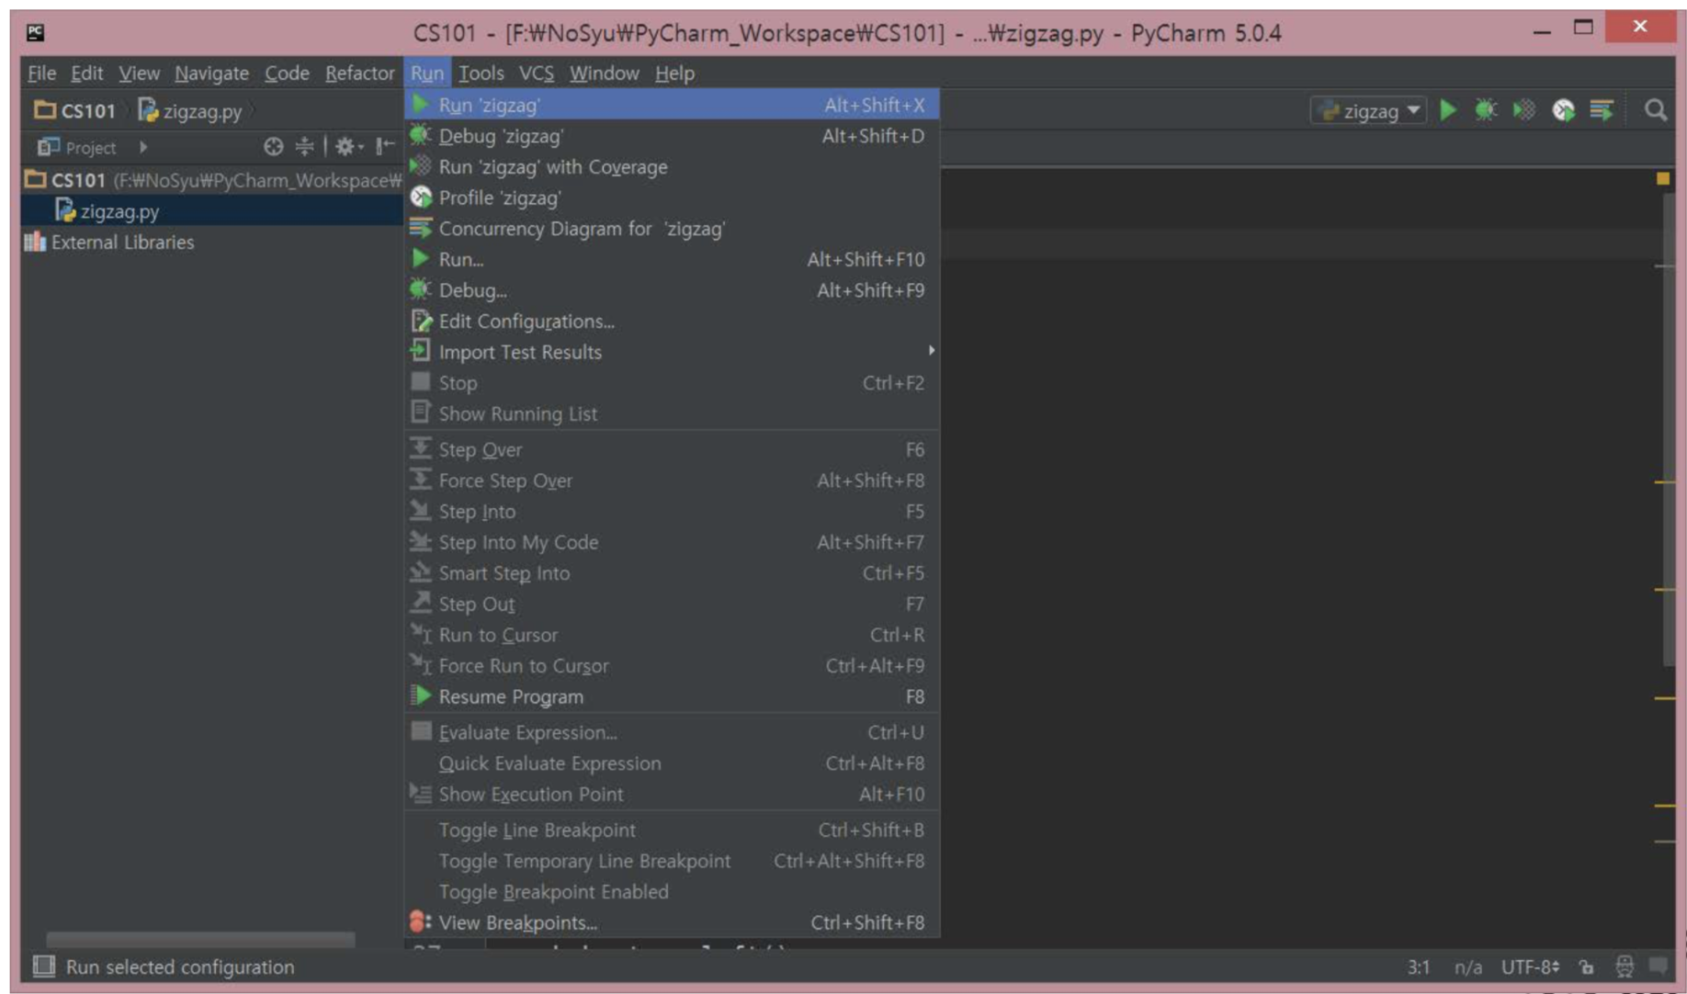
Run!

Slide 76

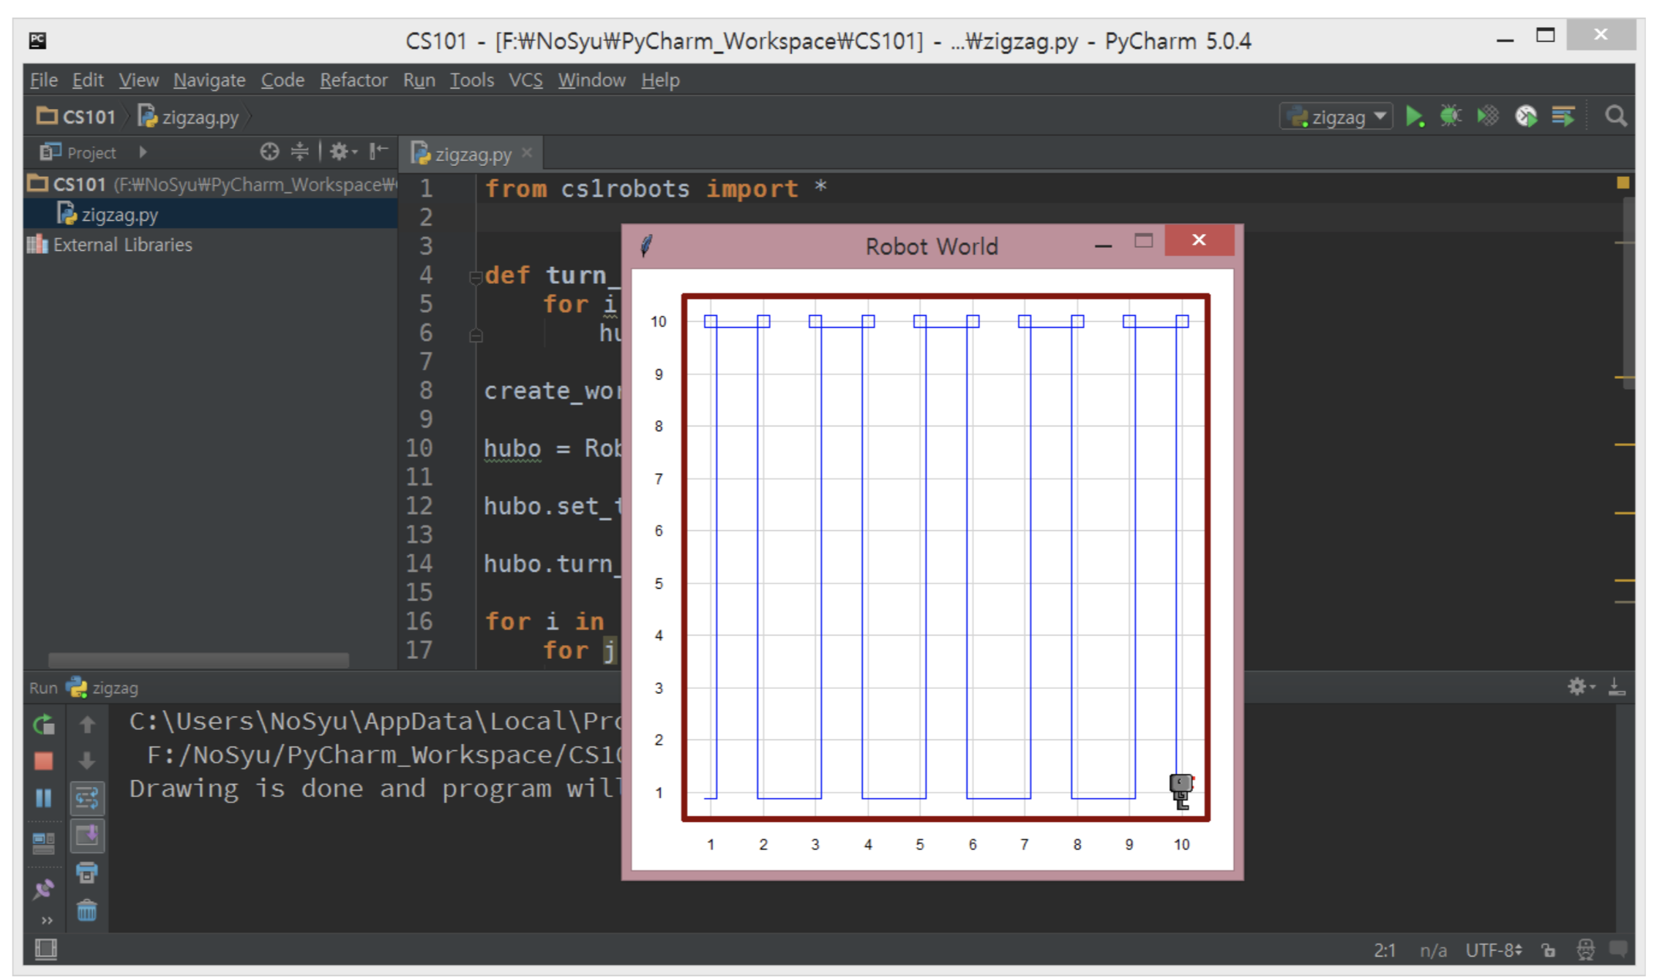
Tada!!

Slide 77
Please make sure you set up a python environment at home(dorm)!
If you have any problems, come back to Lab 2 and let us know

Slide 78
Week 1 Review + Preview

Slide 79
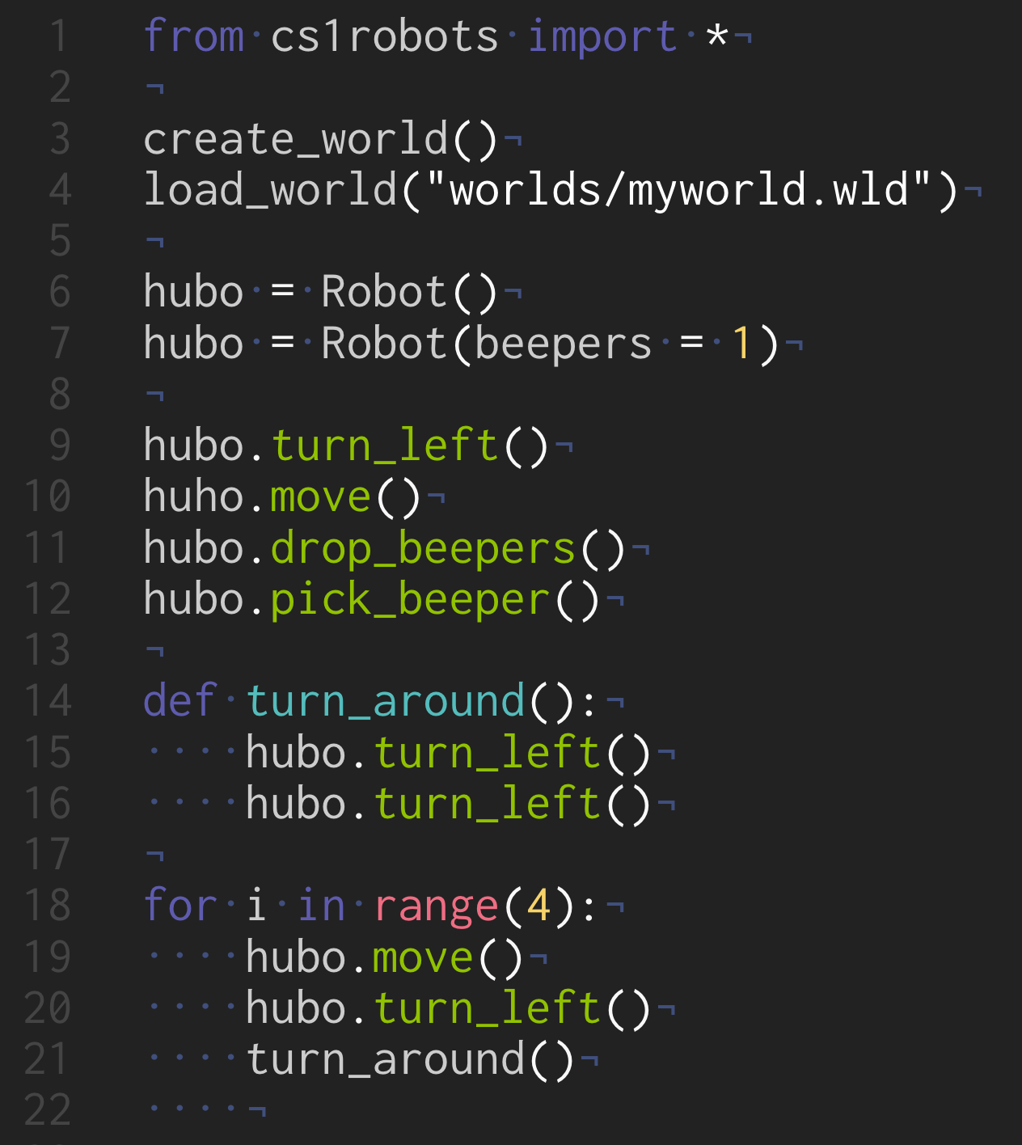
Robotnotes + Worlds
cs101.kaist.ac.kr → robot notes
cs101.kaist.ac.kr → robot worlds

Slide 80
questions?

